Slide 1
Bringing data science and AI/ML tools to infectious disease research
Day 1 Skills Workshop
Computational Environment

Slide 2
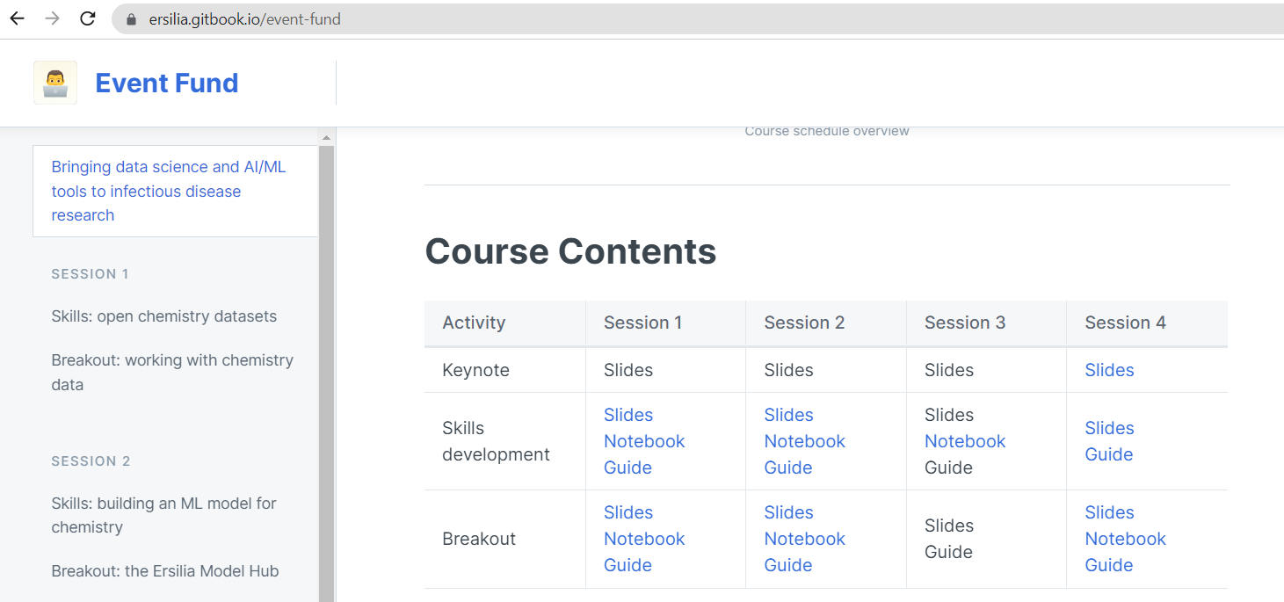
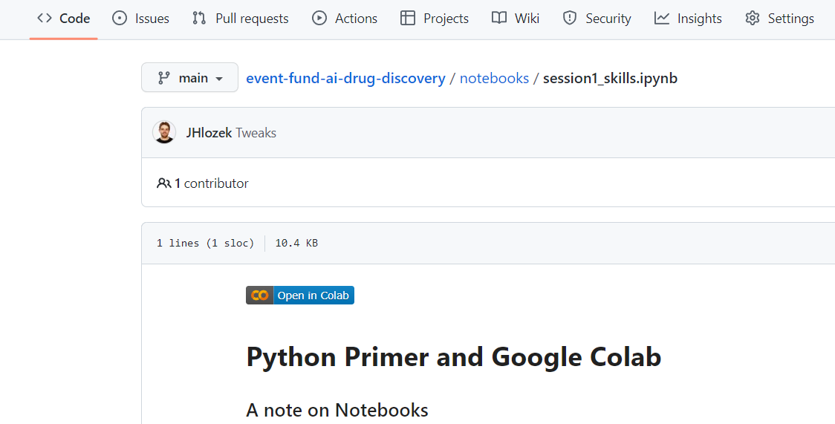

In Preparation:
1) Open your first Colab notebook from:
https://ersilia.gitbook.io/event-fund/
2) Open Google Drive
Make sure you’re signed into your Google account you want to use for the course, both in Google Drive and Colab.

Slide 3
Outline
Intro to Python / Notebooks / Google Colab
Linking to Google Drive
Intro to Chemical Databases
Visualise Data Distribution
Activity

Slide 4


Programming Languages
This?
Maybe this?
https://www.istockphoto.com/photo/binary-code-background-gm1046046242-279903080
https://techcrunch.com/2019/03/18/how-to-build-the-matrix/

Slide 5
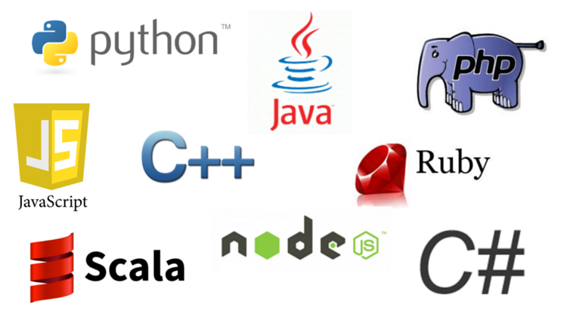
Programming Languages
A set of rules that converts human-readable text to machine code.
Why not just use English?
Ambiguous and imprecise.
E.g. “I saw the man in the park with the telescope.”
Programming language instructions are precise and only have a single meaning.

Slide 6
Software Building Blocks
Input
Process
Output
Input
Process
Output
Input
Process
Output
Input
Process
Output
Code can be written in modular building blocks and used together to build sophisticated pipelines.

Slide 7
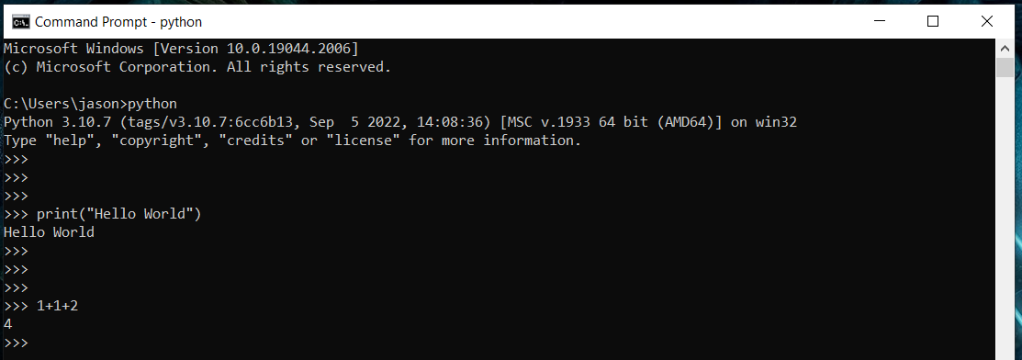
Python
Python is extremely popular because of its flexibility and emphasis on code readability.
It can be run in a terminal window interactively or saved in a file to be executed all together.
However, in data science we prefer ‘notebooks’…

Slide 8
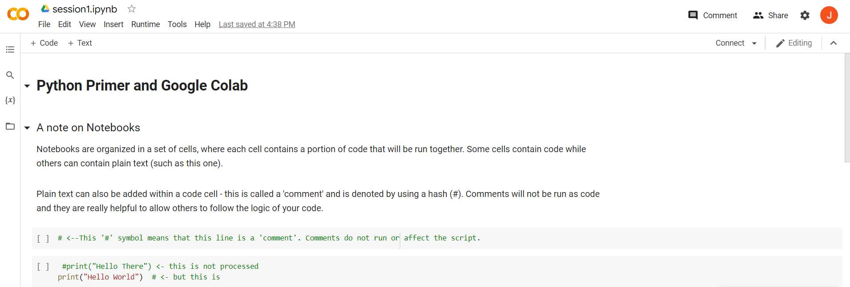
Notebooks
Notebooks allow us to run small pieces of code at a time without re-running an entire file.
We can also interleave plain text between code blocks.

Slide 9
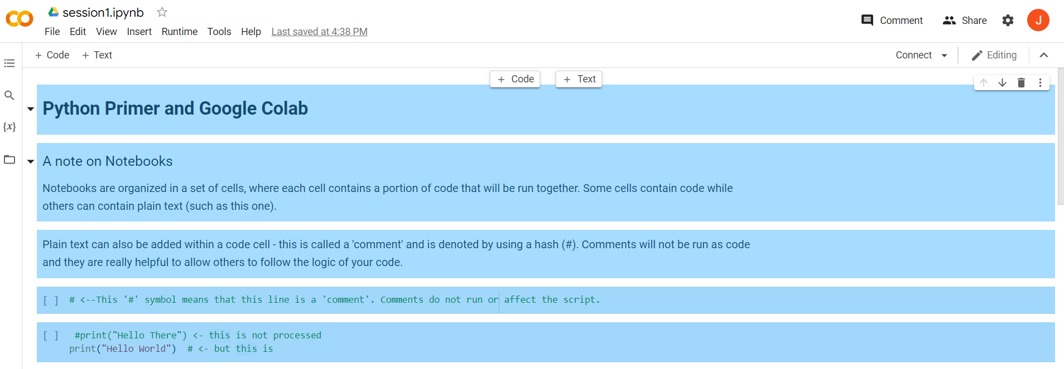
Notebooks
Notebooks consist of ‘cells’ of either code or text.
We’ll be using Google Colab notebooks for this workshop.

Slide 10
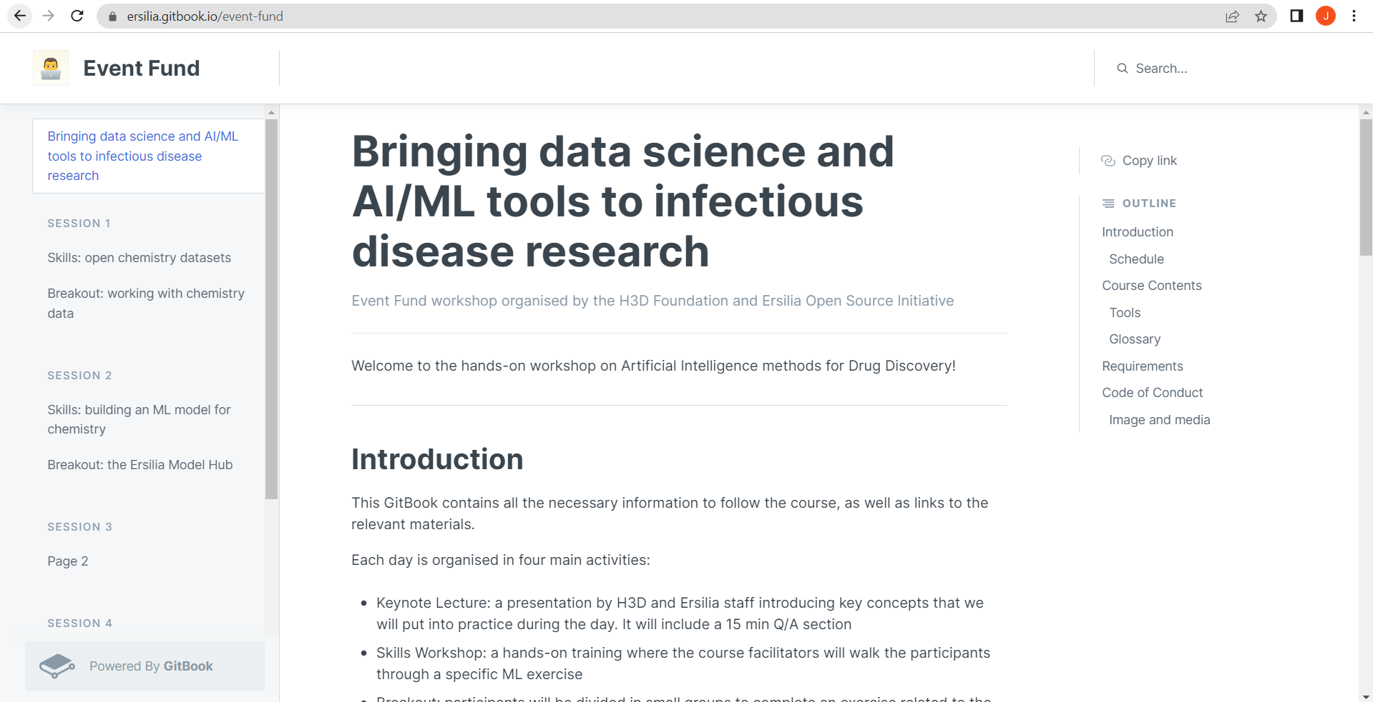
Gitbook Event Resources
Find your first notebook on:
https://ersilia.gitbook.io/event-fund/

Slide 11
In Preparation:
1) Open your first Colab notebook from:
https://ersilia.gitbook.io/event-fund/
2) Open Google Drive
Make sure you’re signed into your Google account you want to use for the course, both in Google Drive and Colab.

Slide 12
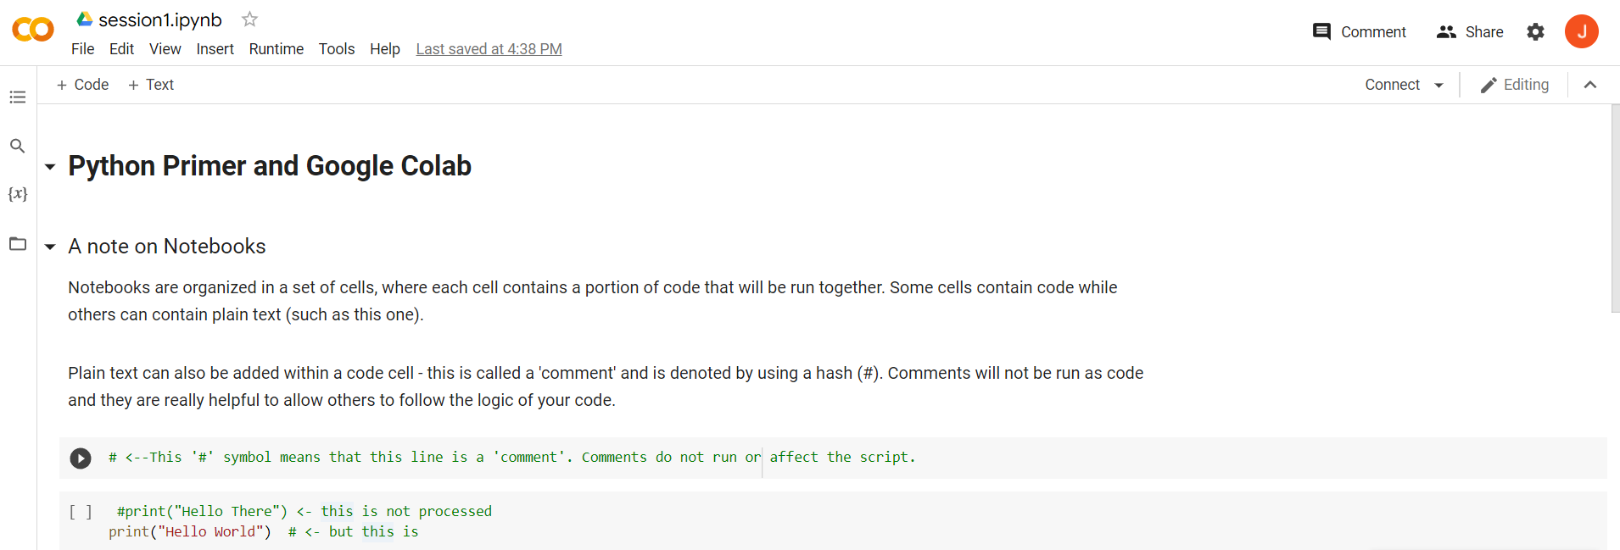

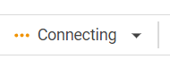
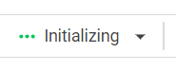


Notebooks
Once the first code block is run, Google will allocate some computing resources for us on the cloud.

Slide 13
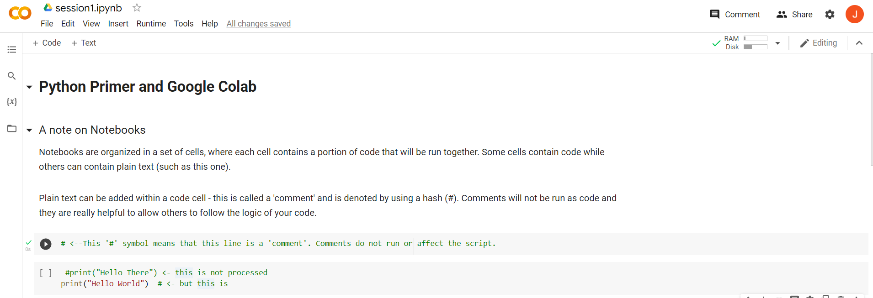
Executing a Cell
Run the first code block.
Notes:
Learning (any) language takes practice.
All code is written for you.
Let’s familiarise ourselves with some concepts.

Slide 14
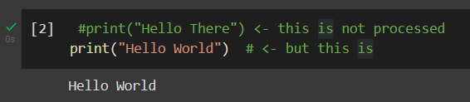

First Python Commands
Python command
Output
Comments are plain text that aid code-readability.
Python commands in a cell are all executed after pressing the ‘run’ button.
Notes:
Black cells will correspond to cells you can run. Run the code blocks as we go along.

Slide 15
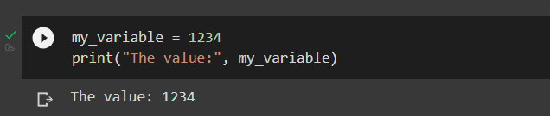
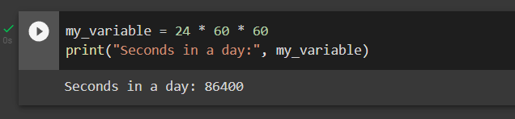
Python: Variables
Variables store data to be referenced later using the variable’s name.
Variables are assigned or reassigned with the ‘=‘ operator.

Slide 16
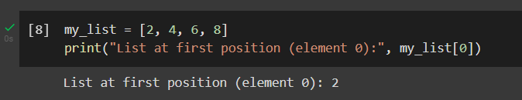
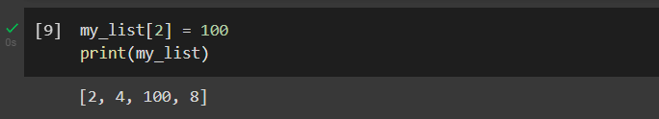
Python: Data Types (Lists)
All data has an associated ‘type’.
Lists are useful type for storing collections of data in a single variable.
Lists are denoted with ‘[ ]’ and are zero-indexed.

Slide 17
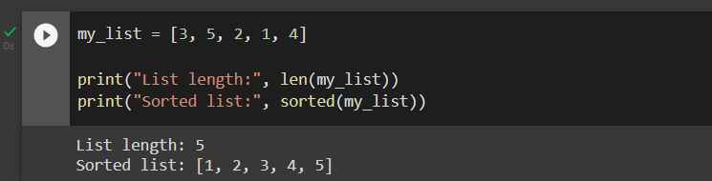
Python: Functions
A ‘function’ is a reusable block of code that performs a specific task and avoids code duplication.
Functions are called with their name and additional data in ‘( )’.
There are many built-in Python functions.

Slide 18
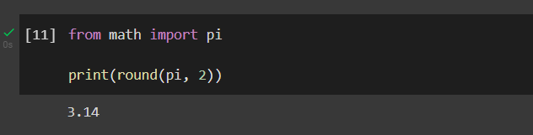

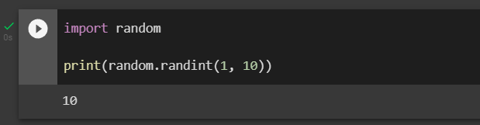
Python: Functions
Functions can be shared between programs.
To use external packages and functions, we ‘import’ them into our workspace.
Notes:
Just as for spoken languages, programming takes practice to get to know what’s out there.
But most of all, Google is your friend.

Slide 19

The Secret…
https://twitter.com/programmersmeme/status/1243850868082053121
Notes:
Most of all, just know that variables and functions exist.

Slide 20
Bringing data science and AI/ML tools to infectious disease research
Day 1 Skills Workshop
Google Drive

Slide 21
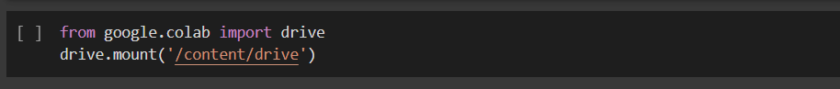
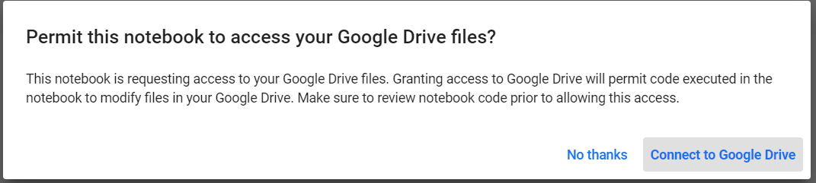
Linking to Google Drive
We can link our Colab Notebook to Google Drive to store and work on files.
Grant Google Colab access to your Google Drive.

Slide 22
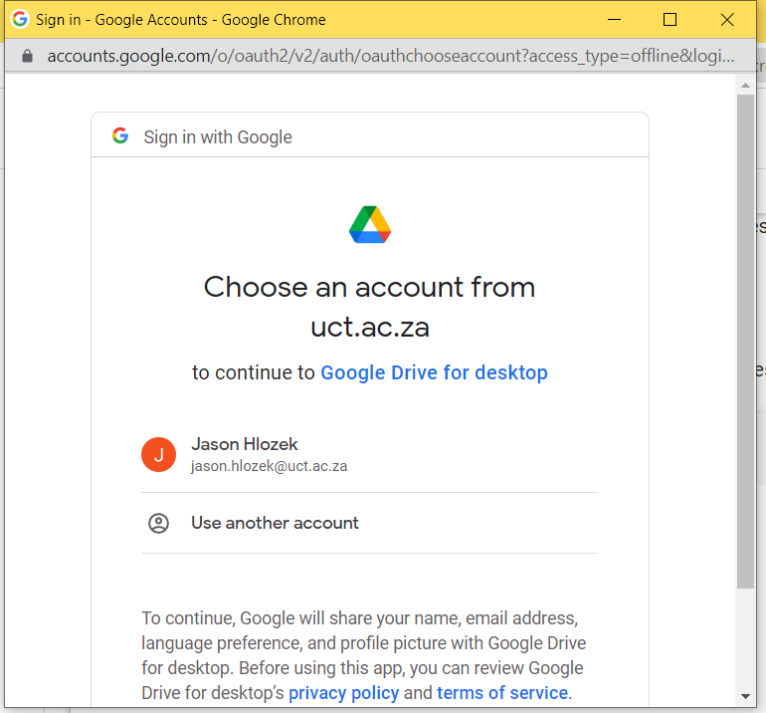

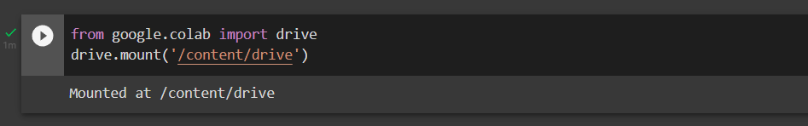
Linking to Google Drive
When complete, you should see:

Slide 23
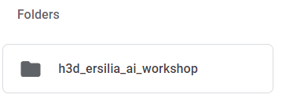
Linux Commands
Colab runs within a Linux environment.
We run Linux commands with a preceding ‘!’.
In Google Drive (might need to refresh the page):

Slide 24
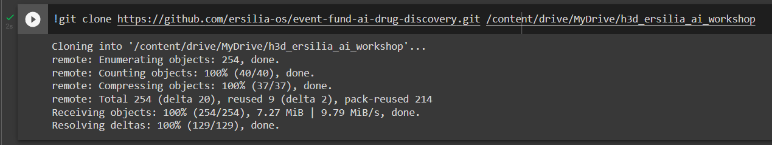
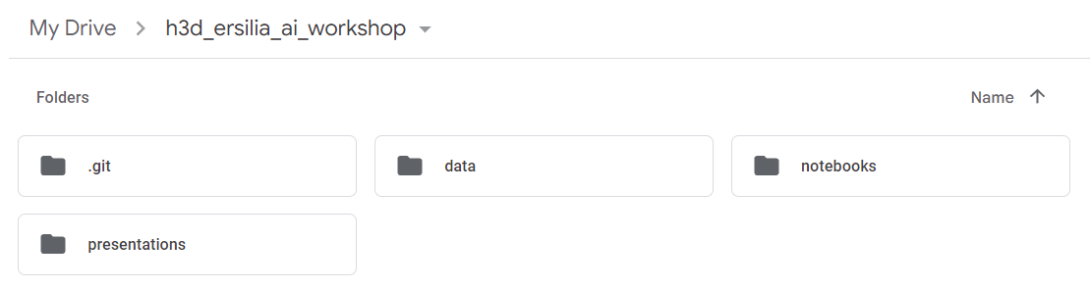
Linux Commands
Now we’ll make a copy of the workshop resources into the new folder.
Our ‘h3d_ersilia_ai_workshop’ folder is no longer empty.

Slide 25
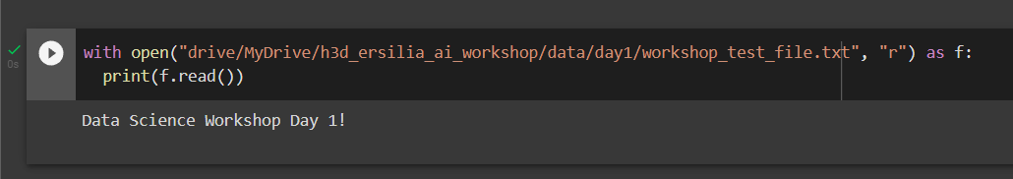
Linux Commands
Let’s check if we can read the test file in the folder.

Slide 26
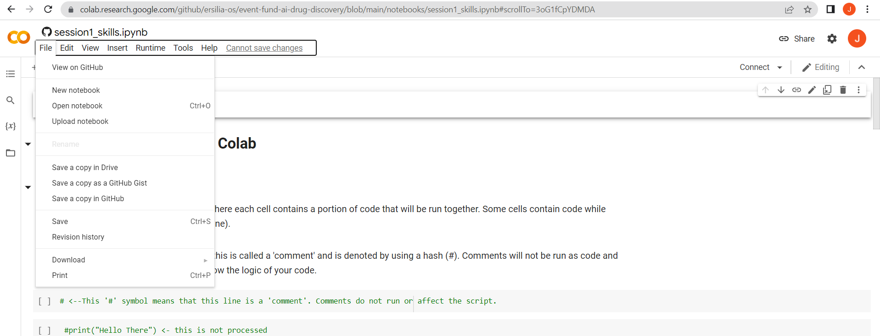
Saving a Notebook Copy
If you want to save edits to your notebook, save a copy to Google Drive: select ‘File’ -> ‘Save a Copy in Drive’

Slide 27
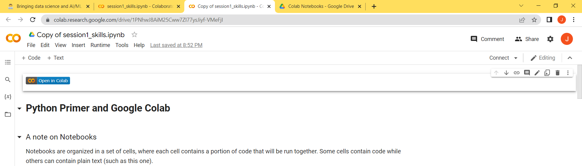
Saving a Notebook Copy
The copy is save to Google Drive and opened in a new tab.

Slide 28
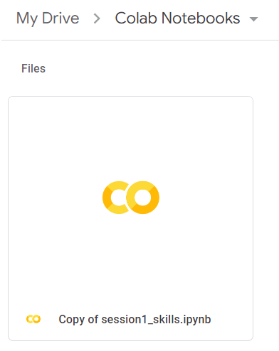
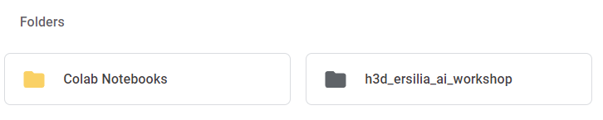
Saving a Notebook Copy
In your Google Drive, you will now have a ‘Colab Notebooks’ folder.
Copies of notebooks will be saved here.

Slide 29
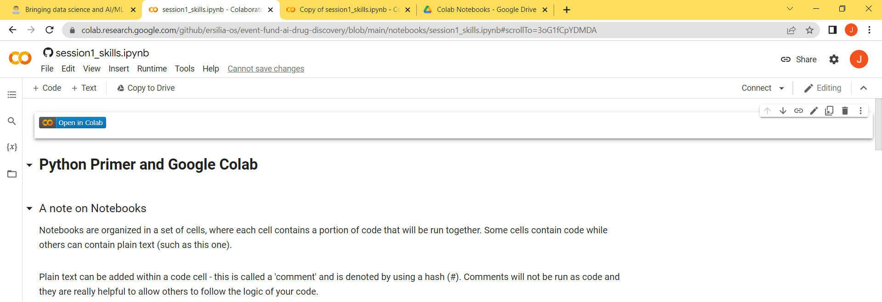
Back to the Original Notebook
Let’s go back to our original notebook and continue.

Slide 30
Bringing data science and AI/ML tools to infectious disease research
Day 1 Skills Workshop
Chemical Databases

Slide 31
How many drug-like molecules are there?
Just for small organic drug-like molecules: 10⁶⁰
That’s:
1 000 000 000 000 000 000 000 000 000 000 000 000 000 000 000 000 000 000 000 000
Meanwhile, the largest databases list less than: ~10⁹
That’s only:
1 000 000 000
Therefore, much to gain from computational tools.

Slide 32





Open Access Chemical Databases
PubChem
Largest database of chemical bioactivity against their assays.
ChEMBL
Manually curated bioactivity database for drug-like molecules.
Therapeutic Data Commons (TDC)
Platform for AI-ready datasets for drug discovery.
Community for Open-Antimicrobial Drug Discovery
Community driven screening for antibiotics.
ZINC
Collection of commercially available compounds for screening.

Slide 33
ChEMBL
Chemical database of the European Molecular Biology Laboratory
Database of structured bioactivity data for small organic molecules.
2.3 million compounds
Includes binding, whole-cell phenotypes, ADMET
Manually curated from:
Medicinal chemistry journals
PubChem BioAssay
Other free databases, e.g. DrugMatrix
Deposited datasets. e.g. GSK, MMV

Slide 34
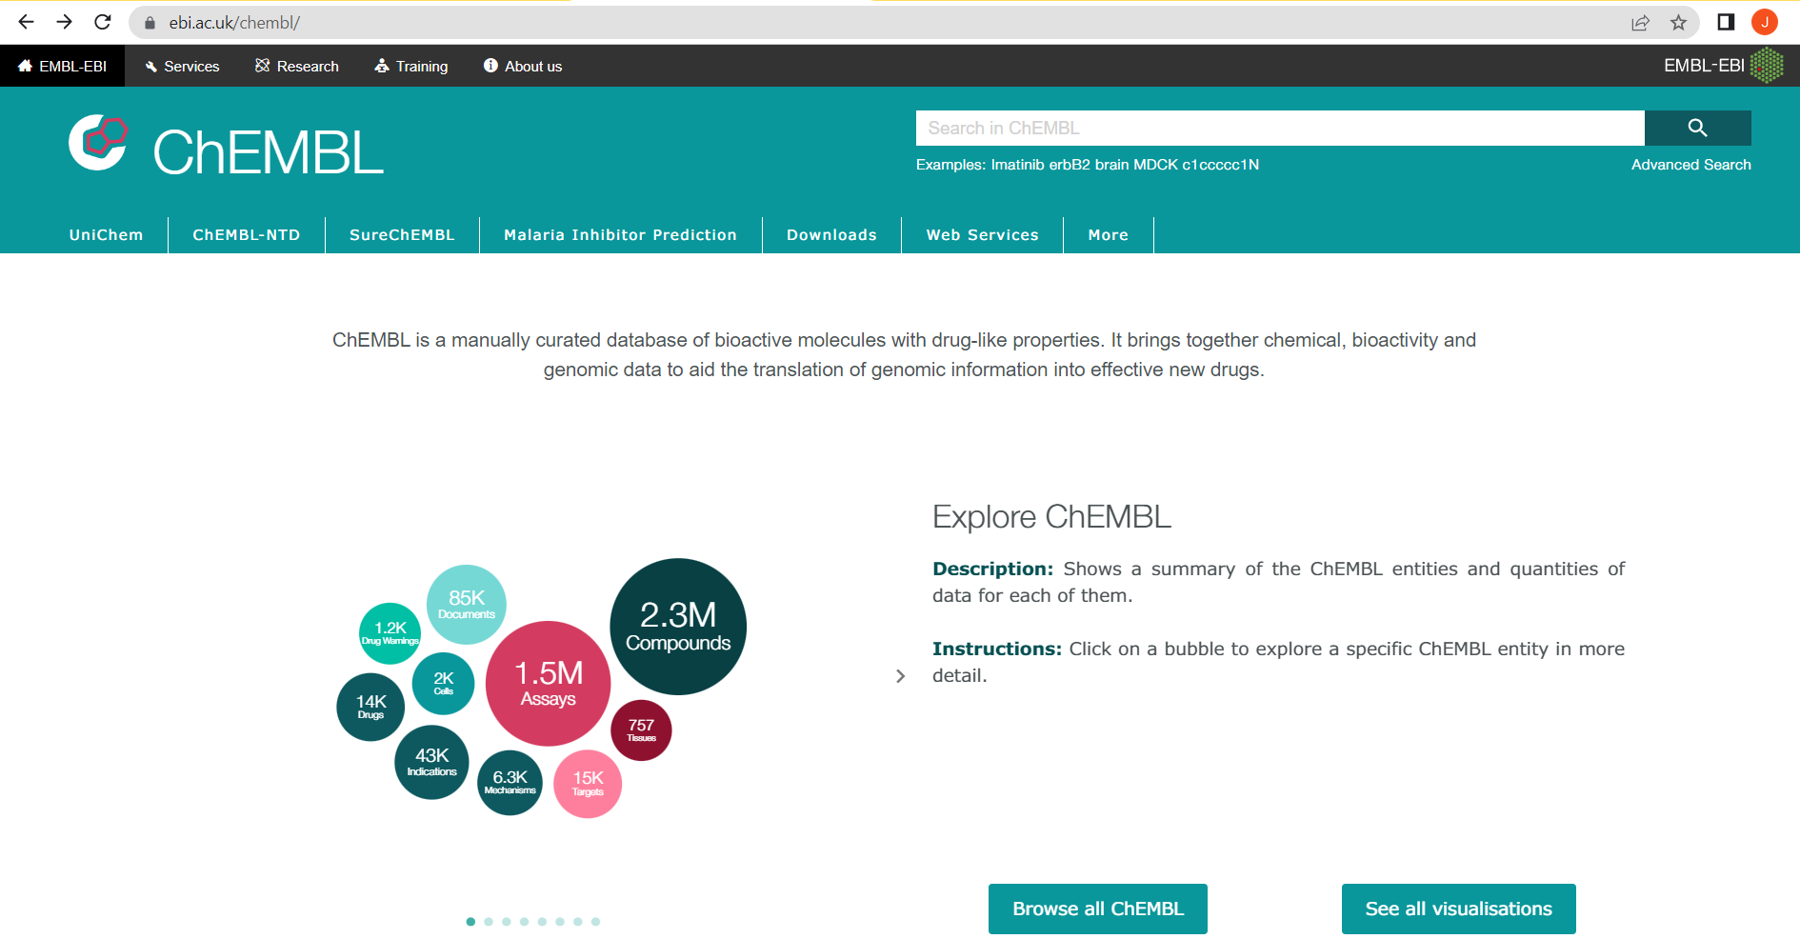
ChEMBL

Slide 35
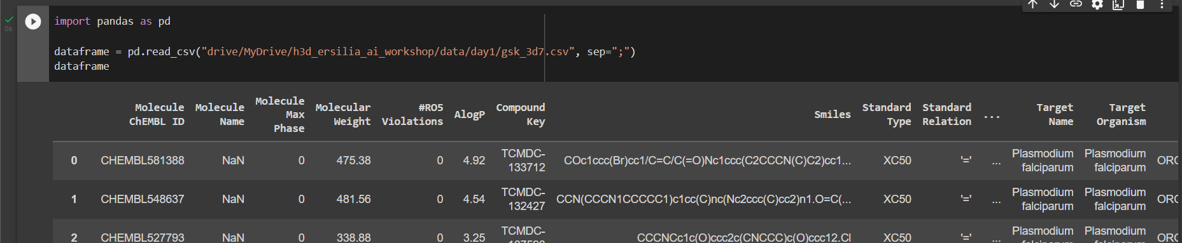
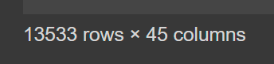
Loading Data with Pandas
Pandas is a data analysis Python package and particularly popular in data science.
We’ll use Pandas to load an example malaria screening dataset from ChEMBL.

Slide 36
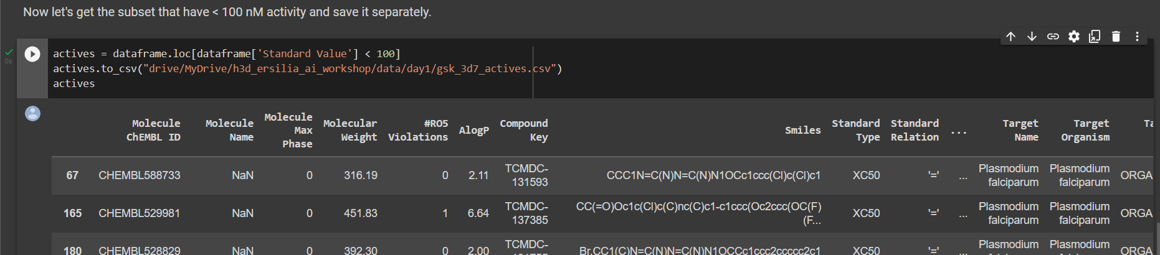
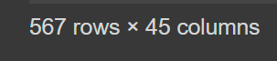
Loading Data with Pandas
ChEMBL datasets have a “Standard Value” column that we’ll use to select compounds with < 100 nM activity.
You’ll be seeing more Pandas usage in the next days.

Slide 37
Bringing data science and AI/ML tools to infectious disease research
Day 1 Skills Workshop
Visualising Chemical Distribution

Slide 38
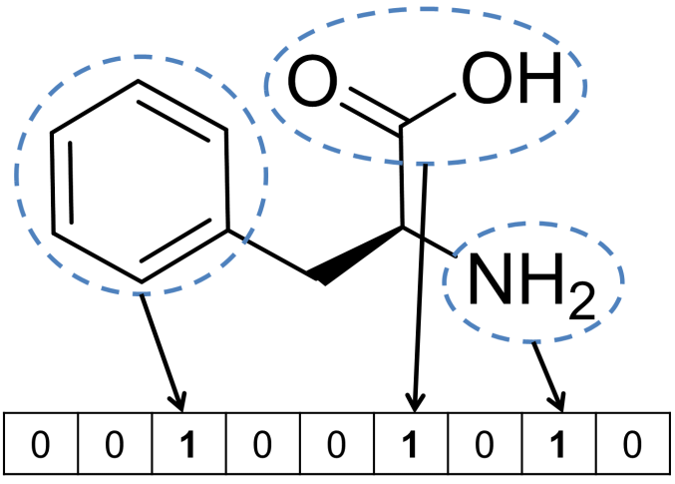
Describing Molecules
Computers only understand numbers, so we need to convert the SMILES strings.
A bit vector is a list of ‘1’ and ‘0’ values, where each bit corresponds to a fragment in the molecule (for example).
Bajusz, D., Rácz, A., & Héberger, K. (2017). Compr. Med. Chem. III, 3, 8.

Slide 39
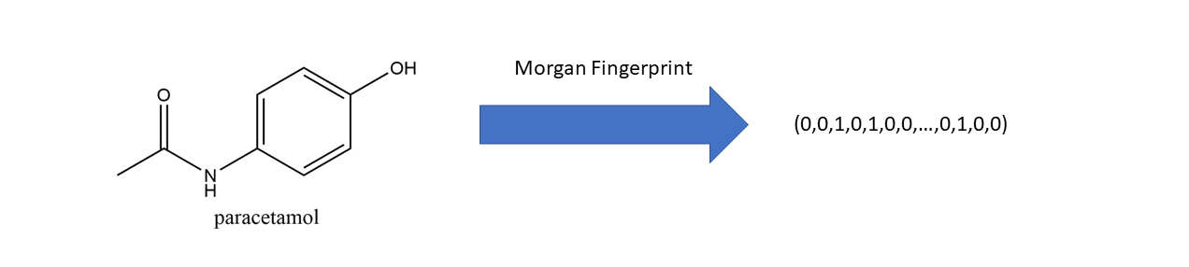
Describing Molecules
Behind the scenes, we’re creating bit vectors of length 2048 to describe our compounds with enough detail.
However, to visualise our chemical distribution, we need to reduce this data to two dimensions.
But we need
n = 2 for plotting
n = 2048
https://towardsdatascience.com/a-practical-introduction-to-the-use-of-molecular-fingerprints-in-drug-discovery-7f15021be2b1

Slide 40
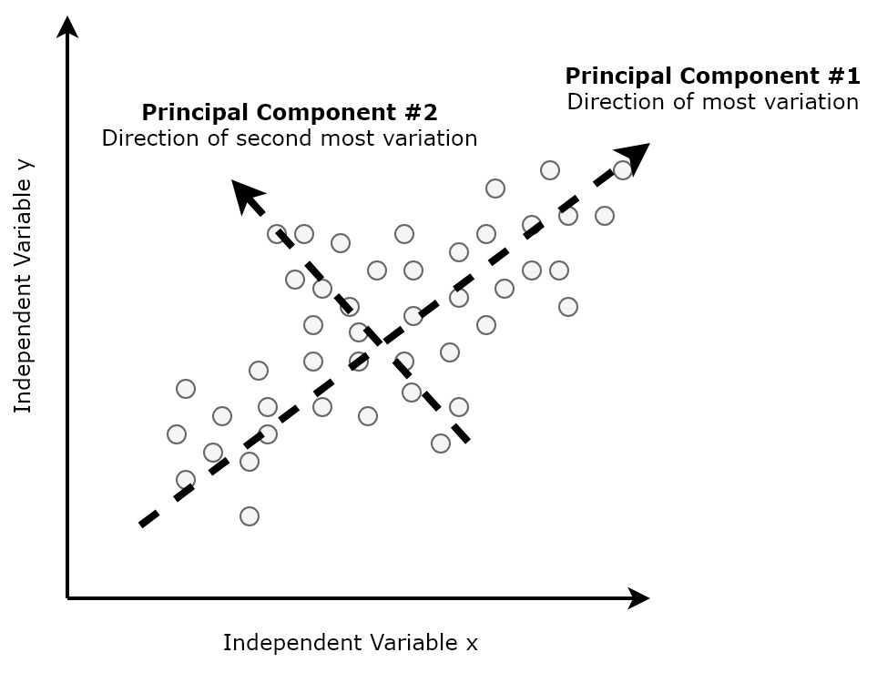
Dimensionality Reduction: PCA
Reducing data to fewer dimensions.
Principal Component Analysis, finds new axes in data in a manner that maximises data point variance.
https://towardsdatascience.com/dimensionality-reduction-for-data-visualization-pca-vs-tsne-vs-umap-be4aa7b1cb29

Slide 41
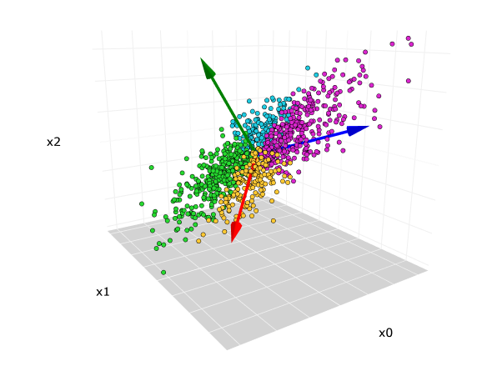
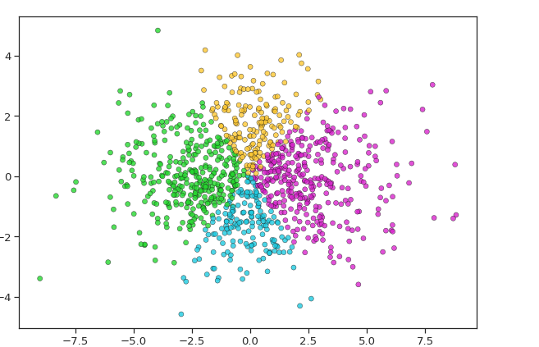
Dimensionality Reduction: PCA
Once new axes are determined for high-dimensional data, datasets can be scaled down to two dimensions.
PC1
Principal Component 2
PC2
Principal Component 1
(1.4 , 2.2)
n = 2048
n = 2
https://towardsdatascience.com/principal-component-analysis-pca-explained-visually-with-zero-math-1cbf392b9e7d
Notes:
Just need to know that this allows us to go from many dimensions down to 2 for plotting.

Slide 42
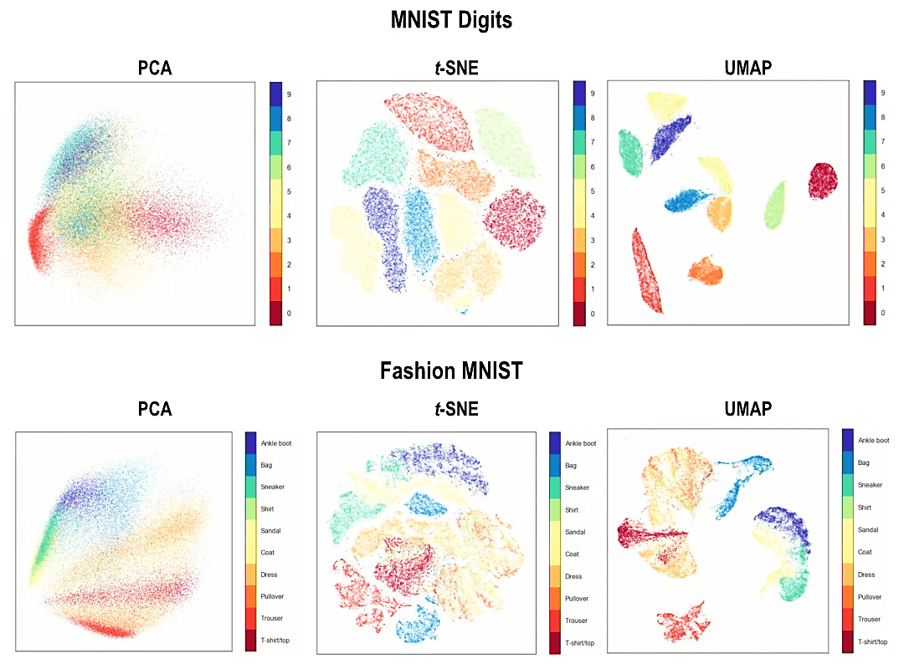
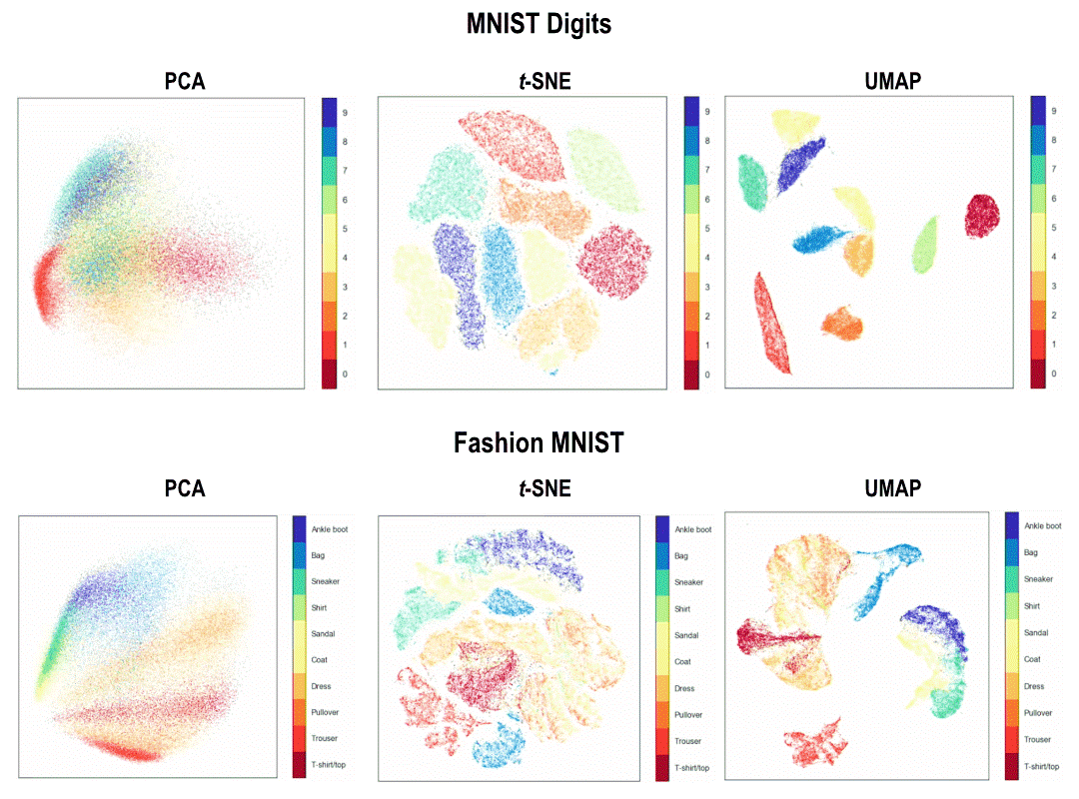
Dimensionality Reduction: PCA vs UMAP
A PCA retains global structure but does not necessarily preserve local groupings of similar datapoints.
A UMAP is an alternative data transformation that emphasizes preserving local clustering of datapoints.
PCA
UMAP
Principal Component 2
Dimension 2
Principal Component 1
Dimension 1
https://meta.caspershire.net/umap/

Slide 43
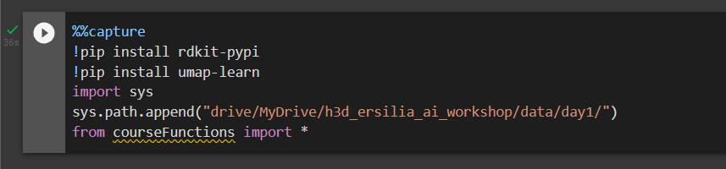
Installing Python Tools for Plots
Let’s install some additional packages to visualise our data distribution – this may take a minute.
RDKit is a toolkit to support various cheminformatics and ML workflows. It will convert our structures to bit vectors.
The remaining packages will aid us in plotting data.

Slide 44
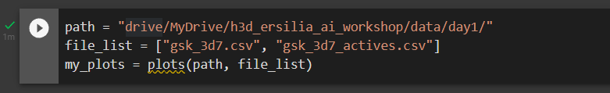
PCA and UMAP Plots (GSK data)
Let’s plot the GSK screening data with the PCA and UMAP dimensionality reduction methods.
The ’plots()’ function from the courseFunctions.py file will process our data through the two algorithms.
It expects a path and a list of file names:

Slide 45
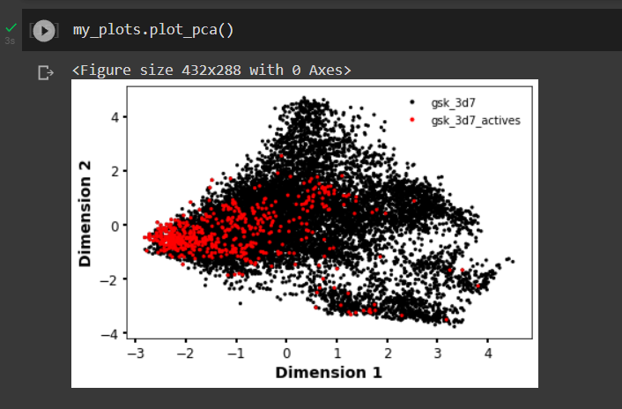
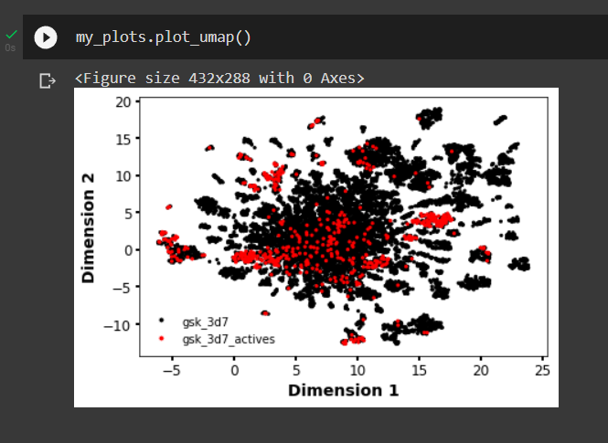
PCA and UMAP Plots (GSK data)
Then we display the plots.
Note: Not all regions are equally active.

Slide 46
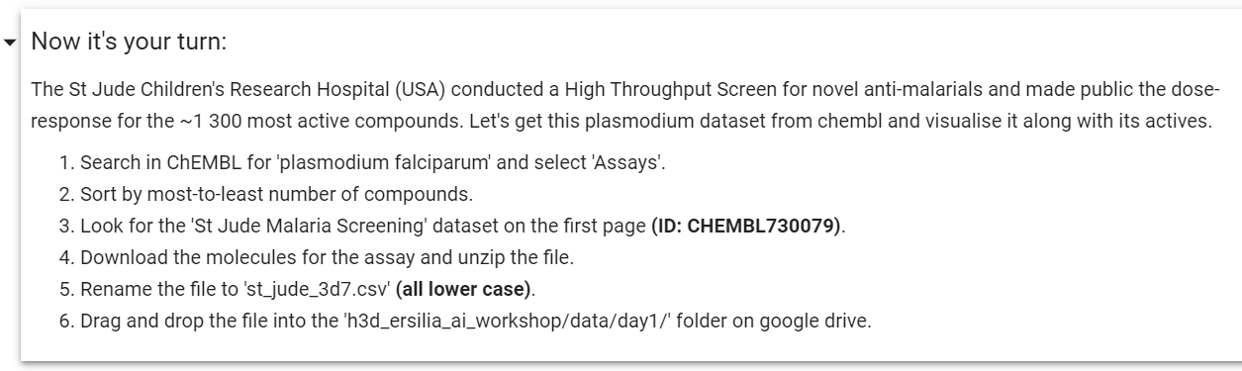
Activity: Hands-on ChEMBL
Now to fetch your own dataset from ChEMBL:

Slide 47
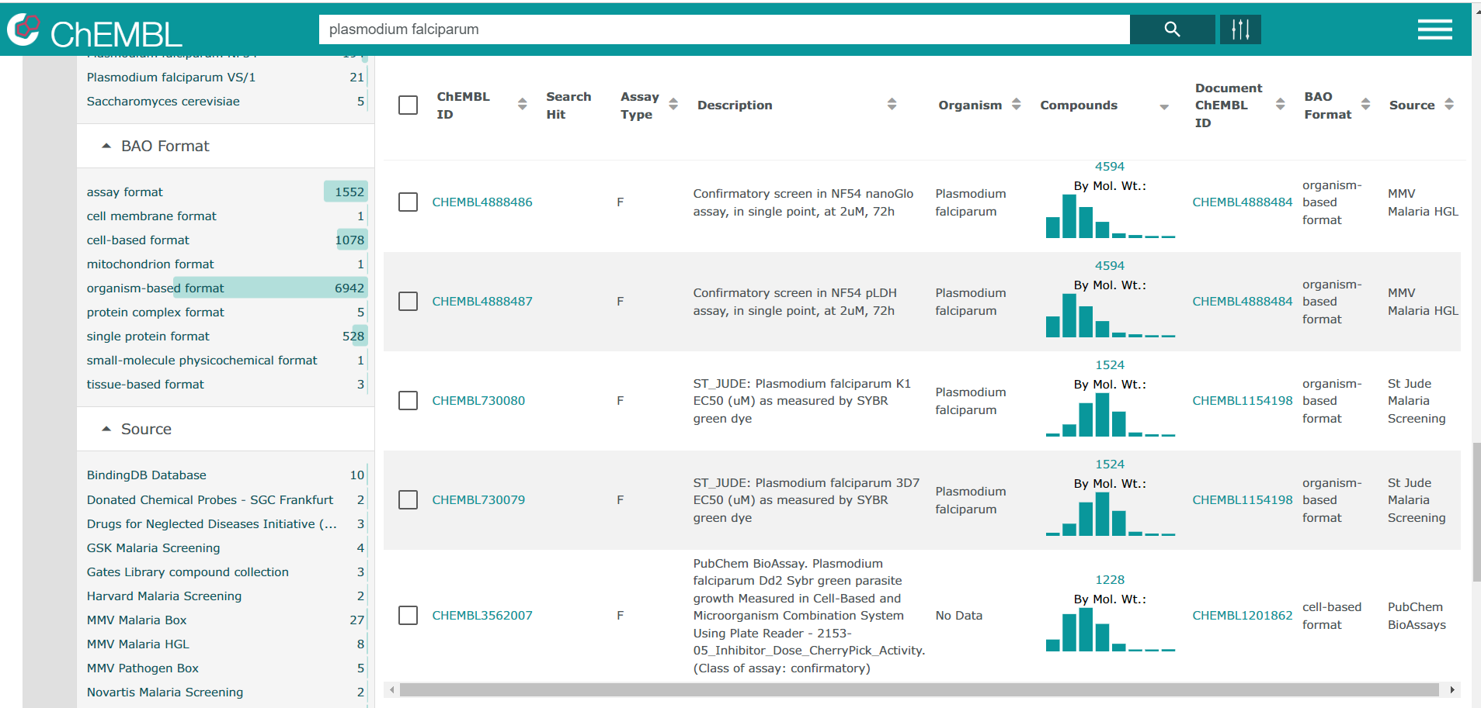
Hands-on ChEMBL
Now to fetch your own dataset from ChEMBL:
(not this one)

Slide 48


Hands-on ChEMBL (St Jude)
As we did with the GSK dataset, let’s save the compounds with < 100 nM activity separately:
And then plot the datasets.

Slide 49


Hands-on ChEMBL Plots
This dataset appears less structurally diverse and less potent overall.
We still observe pockets of activity.

